Slide 1
Fast Convergence PageRank An Implementation of Apache’s Hadoop Framework Using Web Graphs
Presented by: Ben Perry Chantelle Farmer Matthew Green
CS 5300 – Large Scale Information Systems
Professor: Alan Demers TA’s: Bailu Ding & Tao Zou
Thursday, May 2nd, 2013

Slide 2
Agenda
Problem Definition
Filtering The File
Single Node Approach
Results
Blocked Node Approach
Results
Questions & Feedback

Slide 3
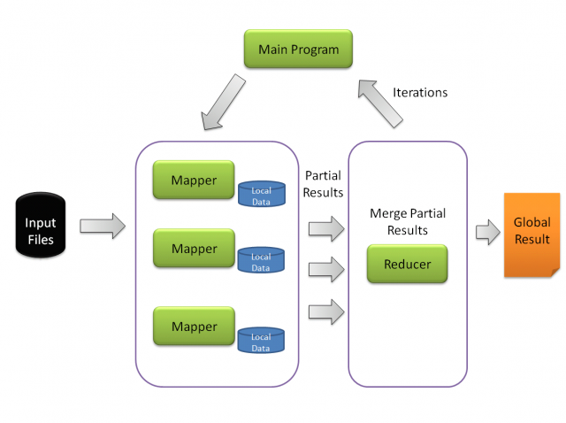
Problem Definition
Use MapReduce to traverse a Web Graph of 685230 nodes & 7600595 edges and compute the overall PageRank by arriving at the asymptote where the terminal value is 0.001.
Demonstrate this process in an inefficient node by node approach and then by a block partition approach to show which is quicker.
Photo Courtesy of: http://salsahpc.indiana.edu/b649proj/images/proj6_MapReducePageRank_0.png

Slide 4


Filtering The File
Transformed edges.txt to [node(u), PR(1/N), deg(u), [EdgeList]].
Edges.txt
PreProcessedFile.txt
Filtered the file to remove 0.998754% of the entries in edges.txt.
Using NetID mcg67:
fromNetID = 0.76.
rejectMin = 0.99 * fromNetID | Reject Min: 0.752400.
rejectLimit = rejectMin + 0.01 | Reject Limit: 0.762400.

Slide 5
Single Node MapReduce

Slide 6
Traversing The Graph Node By Node
Ran the task six times by using a for loop in the Driver (NodeDriver).
Residual Error was calculated after each pass and printed to the console, that console output was also printed to a file where we parsed the amounts.
Used a Hadoop Counters as a Long with transformation factor of 10000 to keep our residual error (static enum RESIDUAL_ERROR) precision.

Slide 7
Mapper & Reducer Tasks
Mapper: Passed along previous pageRank and outgoing edgelist (map key:node value:PR pageRank <outgoing edgelist>) where “PR” is a message type emit.
Also for each edge – (map key:nodeOut value:pageRankFactor) where the pageRankFactor is used by the reducer to calculate the new pageRank for the outgoing edges.
Reducer: Parsed the incoming messages from the mapper, computed the new PageRank and Residual Error and then updated the RESIDUAL_ERROR enum with the new value.

Slide 8

Single Node Results
After 6 passes:
Residual error for iteration 0: 2.3370.
Residual error for iteration 1: 0.3229.
Residual error for iteration 2: 0.1921.
Residual error for iteration 3: 0.0941.
Residual error for iteration 4: 0.0628.
Residual error for iteration 5: 0.0339.
Convergence!

Slide 9
Blocked Approach MapReduce

Slide 10
Blocking Nodes For Efficiency
Blocked the nodes using a technique whereby we used Math.floor(nodeID / partitionSize) to get an int which we then tested against the hard coded array of blocks blockBoundaries[] from blocks.txt.
A Python script was used to verify the correctness of the blocks using nodes.txt.

Slide 11
Mapper & Reducer Tasks
Mapper: Very similar to the single node mapper but also handles the grouping of the nodes into blocks using the aforementioned technique.
It emits more messages this time, the list edges within a block, the list of boundary edges and all the nodes within a block.
Reducer: Iterates over the block ‘X’(5) times or until convergence, whichever comes first. Then the residual error is calculated by taking the average residual error for all nodes in that block between the starting and ending values of PageRank.

Slide 12
Blocked Approach Results
Iterated Within The Block 5 Times.
Residual Errors After 7 Block Level Passes:
Residual Error
Iteration Number | Error
0 | 2.7963
1 | 0.0507
2 | 0.0240
3 | 0.0097
4 | 0.0044
5 | 0.0016
6 | 0.0006
Convergence!

Slide 13
Highest Nodes In Block
Block | Node | PageRank
0 | 10327 | 1.8738E-06
1 | 20372 | 5.1603E-07
2 | 30628 | 3.0627E-07
3 | 40644 | 2.8093E-07
4 | 50461 | 2.9953E-07
5 | 60840 | 2.1890E-07
6 | 70590 | 3.0031E-07
7 | 80117 | 2.1890E-07
8 | 90496 | 8.6777E-04
9 | 100500 | 2.5973E-07
10 | 110566 | 2.0256E-06
11 | 120944 | 4.8255E-07
12 | 130998 | 2.3451E-07
13 | 140573 | 6.2570E-07
14 | 150952 | 2.1890E-07
15 | 161331 | 2.1890E-07
16 | 171153 | 5.6246E-07
17 | 181513 | 3.5344E-07
18 | 191624 | 5.2775E-06
19 | 202003 | 4.0817E-06
20 | 212382 | 2.6169E-07
21 | 222761 | 1.2090E-03
22 | 232592 | 1.0456E-04
23 | 242877 | 5.5511E-07
24 | 252937 | 2.1890E-07
25 | 263148 | 3.0361E-07
26 | 273209 | 2.1890E-07
27 | 283472 | 2.1890E-07
28 | 293254 | 2.6169E-07
29 | 303042 | 4.8075E-06
30 | 313369 | 8.9155E-07
31 | 323521 | 2.1890E-07
32 | 333882 | 5.1568E-07
33 | 343662 | 2.5169E-07
34 | 353644 | 4.0106E-07
35 | 363928 | 3.6064E-07
36 | 374235 | 3.8351E-06
37 | 384553 | 4.1396E-07
38 | 394928 | 2.3993E-07
39 | 404711 | 2.4664E-07
40 | 414616 | 3.1175E-07
Block | Node | PageRank
41 | 424746 | 1.7133E-06
42 | 434706 | 2.4184E-06
43 | 444488 | 3.8157E-06
44 | 454284 | 4.9752E-07
45 | 464397 | 1.1568E-05
46 | 474195 | 7.2929E-07
47 | 484049 | 5.8649E-07
48 | 493967 | 2.1890E-07
49 | 503751 | 7.1029E-06
50 | 514130 | 6.3963E-07
51 | 524509 | 9.8378E-04
52 | 534708 | 2.5547E-05
53 | 545087 | 2.5739E-03
54 | 555466 | 1.1760E-03
55 | 565845 | 1.6406E-06
56 | 576224 | 1.1074E-06
57 | 586603 | 9.5858E-07
58 | 596584 | 3.9972E-06
59 | 606366 | 4.2811E-07
60 | 616147 | 6.1016E-07
61 | 626447 | 1.7597E-05
62 | 636239 | 1.0722E-06
63 | 646021 | 3.1194E-07
64 | 655803 | 2.1890E-07
65 | 665665 | 9.9700E-07
66 | 675447 | 1.0994E-06
67 | 685229 | 3.5826E-07

Slide 14
Key Takeaways
MapReduce Is A Powerful Framework For Big Data
Power Iteration Is Slow But Effective
Blocking Nodes Is More Effective & Leads To Faster Convergence
While A Strong Solution To Big Data Computation Disk I/O Is Still Expensive!

Slide 15
Questions & Feedback

Slide 16
Link To Code
https://github.com/MatthewGreen/CS5300-Project2

